Slide 1

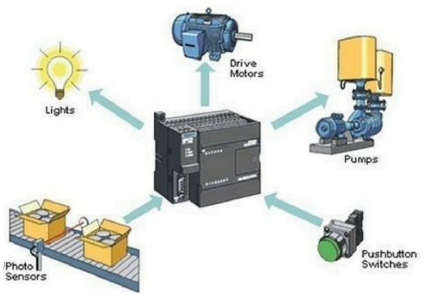
MBEYA UNIVERSITY OF SCIENCE AND TECHNOLOGY COLLEGE OF ENGINEERING AND TECHNOLOGY DEPARTMENT OF MECHANICAL AND INDUSTRIAL ENGINEERING MODULE ME 6215: Programmable Logical Controller I
MODULE ME 6214 Fundamentals of PLC
COURSE CREDIT: 07
Prepared by;
Dr. Masoud Kamoleka Mlela
BSc. Electromechanical Engineering (UDSM)
MSc, Renewable Energy (UDSM)
PhD, Mechanical Engineering (HEU-CN).
Lecture 1

Slide 2
Reading List:
John W. Webb & Ronald A.Reis., (2010). Programmable logic controllers- principles and applications, 5th Edition – PHI Learning Pvt. Ltd., New Delhi -
[Hughes .T, (1989). Programmable Logic Controllers, ISA Press,
John W. Webb & Ronald A. Reis, (2008). Programmable Logic Controllers – Principles and Applications, Fifth Edition, Pearson Education
Ohn R. Hackworth & Frederick D. Hackworth Jr, (2011).Programmable Logic Controllers – Programming Methods and Applications, Pearson
Nakra, B. C., (2014). Theory and Applications of Automatic Controls, Revised 2nd Edition, New Age International Publishers

Slide 3
Introduction; definition & history of the PLC

Slide 4
Introduction to Programmable Logic Controllers (PLCs)
Programmable Logic Controllers (PLCs) are specialized industrial computers designed for automation and control of processes and machinery. They are widely used in manufacturing, energy, transportation, and other industries to enhance efficiency, reliability, and flexibility in operations.

Slide 5
What is a PLC?
A PLC is a microprocessor-based system that uses programmable memory to store instructions for performing specific tasks such as logic operations, sequencing, timing, counting, and arithmetic.
These instructions allow the PLC to control machines and processes by interacting with input/output (I/O) devices like sensors, switches, motors, actuators, and lights
PLCs are robust and designed to operate in harsh industrial environments. They can withstand extreme temperatures, vibrations, and electrical noise while performing real-time applications

Slide 6
PLC Definition
A formal definition of a PLC comes from the National Electrical Manufacturers Association (NEMA):
A digitally operating electronic apparatus which uses a programmable memory for the internal storage of instructions for implementing specific functions such as logic, sequencing, timing, counting, and arithmetic to control, through digital or analog input/output modules, various types of machines or processes.

Slide 7
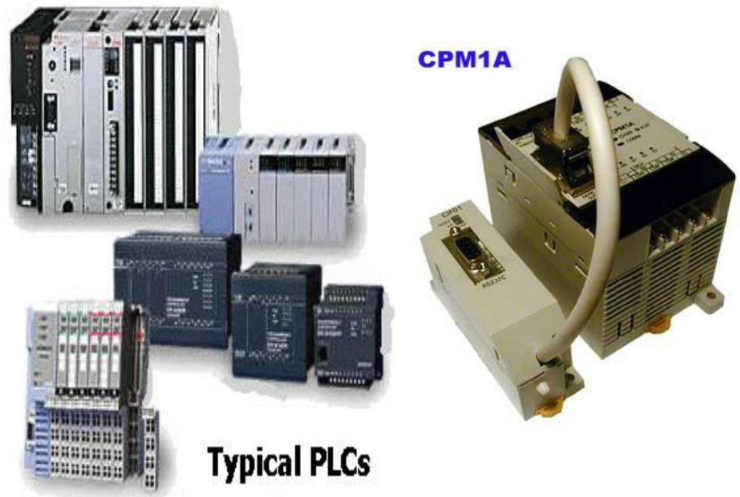

Slide 8
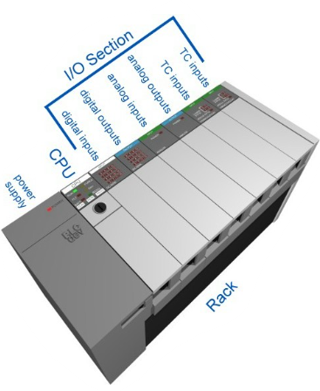
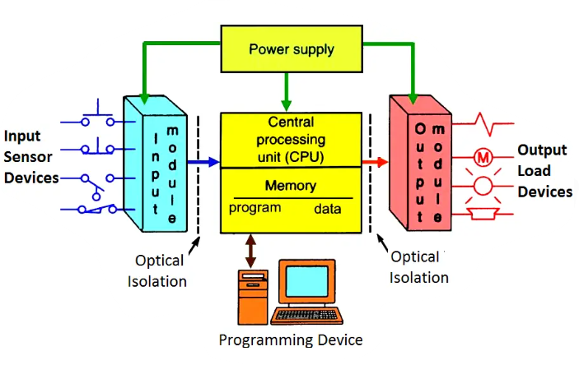

Slide 9
History of PLC
The development of PLCs revolutionized industrial automation by replacing complex and inflexible relay logic systems. Here is a brief timeline of their evolution
Pre-PLC Era: Relay Logic Systems
Before PLCs, industrial automation relied on electromechanical relay systems. These systems were cumbersome due to extensive wiring requirements, limited scalability, and difficulty in troubleshooting. Modifications often required physical rewiring, which was time-consuming and prone to errors

Slide 10
Invention of the First PLC
The concept of the PLC emerged in the late 1960s when the automotive industry—most notably General Motors—sought a more flexible and cost-effective alternative to the complex relay-based control systems used at the time. Traditional systems were difficult to modify and maintain, leading to long downtimes during production changes
The first PLC was developed by Dick Morley for General Motors in 1968. Known as the Modicon 084 (Modular Digital Controller), it was designed to address the limitations of relay systems by offering a programmable solution that could be reconfigured without hardware changes. This innovation laid the foundation for modern industrial automation.
Over the decades, PLCs have evolved from simple relay-replacement devices into powerful control systems capable of advanced functions like motion control, networking, data logging, and integration with modern software platforms. (Modular Digital Controller),

Slide 11
1970s: Commercial Success
By 1973, Michael Greenburg refined the design into a commercially successful product for General Motors and Landis. Around the same time, Allen-Bradley popularized the term "PLC" and became a major manufacturer in the United States
1980s Onward: Technological Advancements
The 1980s saw significant improvements in PLC technology:
Introduction of PC-based software for programming.
Enhanced processing speeds.
Expansion of memory capabilities.
Modern PLCs have evolved further to include features like human-machine interfaces (HMI), predictive maintenance capabilities, and integration with Internet of Things (IoT) technologies

Slide 12
PLC advantage & disadvantage
Programmable Logic Controllers (PLCs) are crucial in automation and control systems. Here are some advantages and disadvantages:
Advantages of PLCs:
Flexibility: PLCs can be easily reprogrammed for various applications, unlike traditional relay-based systems.
Reliability: Designed for industrial environments, they are robust and minimize downtime.
Ease of Troubleshooting: Error messages and diagnostic tools simplify maintenance.
Scalability: PLCs can accommodate expansion with additional I/O modules and connectivity options.
Integration: Can interface with various devices like sensors, actuators, and other PLCs seamlessly.

Slide 13
PLC advantage & disadvantage
Disadvantages of PLCs:
Initial Cost: High initial investment compared to simpler control systems.
Programming Knowledge: Requires specialized programming skills, which may limit accessibility.
Complexity: Large systems can become challenging to manage and troubleshoot.
Reliance on Hardware: System failures may occur if the hardware is compromised or damaged.
Limited High-Speed Performance: Not suitable for extremely fast operations compared to microcontrollers.

Slide 14
PLC versus Computers
Feature | PLC | Computer (PC)
Purpose | Industrial automation & control | General-purpose computing
Operating Environment | Harsh (vibration, dust, temperature, humidity) | Controlled environments (offices, homes)
Reliability | Very high (designed for 24/7 operation) | Moderate (not designed for constant harsh use)
Real-Time Control | Yes, deterministic and fast response | No, not inherently real-time
Programming Languages | Ladder Logic, Structured Text, Function Block | C++, Java, Python, etc.
User Interface | Basic or none (uses HMI/SCADA for UI) | Full GUI with OS like Windows/macOS/Linux
Input/Output (I/O) | Directly connects to sensors and actuators | Needs extra hardware for industrial I/O
Expandability | Modular (I/O modules, comm modules, etc.) | Limited to peripheral devices
Maintenance | Easier in field; hot-swappable modules possible | More complex; not modular for quick changes
Cybersecurity | Proprietary systems are less prone to cyberattacks | More vulnerable to malware and hacking due to widespread usage
Cost | Cheaper for small systems; large PLCs can be expensive | Generally, more affordable for complex tasks but lacks ruggedness
Notes:
A GUI, or Graphical User Interface; HMI stands for Human-Machine Interface; SCADA, which stands for Supervisory Control and Data Acquisition

Slide 15
PLC Application
PLCs are widely used across various industries for automation and control applications. Here are some common areas where PLCs are applied:
Industrial Applications:
Manufacturing Automation: Control of assembly lines, robotic arms, and packaging systems.
Process Control: Regulation of temperature, pressure, and flow in industries like oil and gas, chemical production, and food processing.
Material Handling: Management of conveyor belts, elevators, and sorting systems in warehouses.
Glass Production: PLCs ensure quality by controlling temperature, pressure, and timing during glass manufacturing
Paper Industry: Automates machinery like cutters and presses for precise operations in paper production
Cement Manufacturing: Regulates raw material mixing, kiln operations, and ball mills for efficient cement production

Slide 16
PLC Application
Power Stations
PLCs play a vital role in power generation, transmission, and distribution systems:
Smart Grid Systems: Monitor electrical parameters in real-time to detect faults and optimize power flow.
Power Substation Automation: Automate equipment like transformers and circuit breakers for efficient load management
Transportation Systems
PLCs are essential for controlling transportation systems such as:
Escalators and Elevators: Manage motor speed, door functions, and safety features like emergency stops.
Smart Traffic Control: Adjust traffic signals dynamically based on real-time data from sensors

Slide 17
Types of PLCs by Size
Programmable Logic Controllers (PLCs) are categorized by size based on their input/output (I/O) capacity, memory, and processing power. Below is an overview of the different PLC sizes:
Nano PLC
Description: The smallest type of PLC, often used for basic automation tasks.
Features:
Extremely compact design.
Limited number of I/O points (e.g., fewer than 32).
Minimal memory and processing power.
Applications: Suitable for small-scale projects like college experiments or simple machinery control

Slide 18
Types of PLCs by Size
Micro PLC (Small PLC)
Description: Slightly larger than nano PLCs, designed for controlling smaller machines.
Features:
I/O points range from 32 to 128.
Compact and cost-effective.
Simple programming languages like ladder logic.
Built-in communication ports for external network connections.
Extremely compact design.
Limited number of I/O points (e.g., fewer than 32).
Minimal memory and processing power.
Applications: Ideal for conveyors, motors, and small industrial setups

Slide 19
Types of PLCs by Size
Medium PLC
Description: Larger than micro PLCs and offers more capabilities but less scalability compared to modular PLCs.
Features:
Supports multiple programming languages.
Expandable with additional I/O modules.
Moderate processing power and memory capacity.
Applications: Used in industries like food processing, amusement parks, and medium-scale automation projects

Slide 20
Types of PLCs by Size
Large PLC
Description: Designed for complex industrial applications requiring high scalability and performance.
Features:
Thousands of I/O points (e.g., up to 10,000 or more).
Higher memory and processing power.
Modular design allowing extensive customization..
Applications: Widely used in oil and gas industries, large manufacturing plants, and utilities

Slide 21
Types of PLCs by Size
Very Large PLC
Description: The largest category of PLCs, capable of handling highly complex systems with extensive automation needs.
Features:
More than 20,000 I/O points combined (digital and analog).
Advanced memory and processing capabilities.
Applications: Suitable for large-scale industries such as petrochemicals or utility grids

Slide 22
Key Factors for Classification
PLC size is determined by:
Number of I/O Points: Larger systems require more inputs/outputs to manage complex operations.
Memory Capacity: Bigger systems need more memory to store complex programs and data.
Application Requirements: The choice of PLC size depends on the specific needs of the project or industry

Slide 23
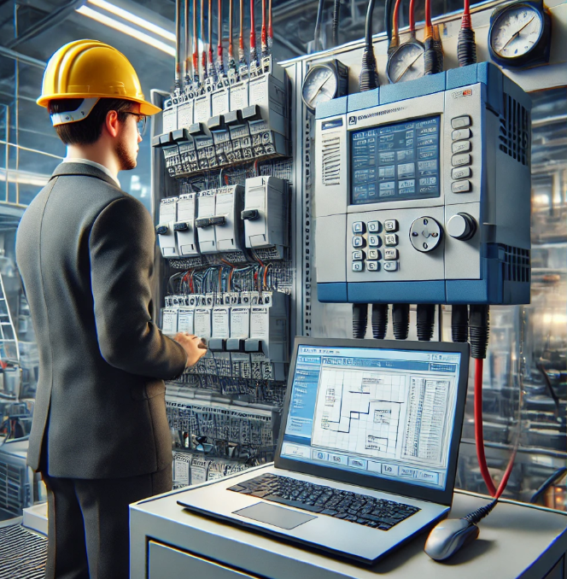
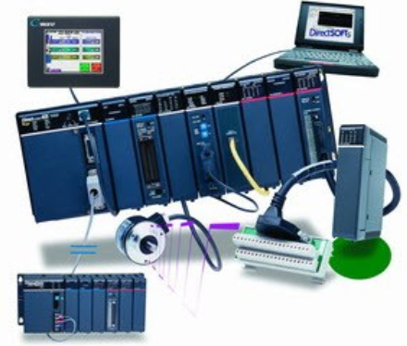
PLC programming equipment

Slide 24
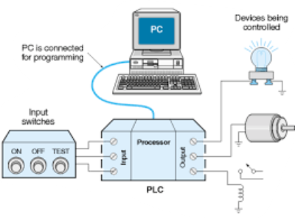
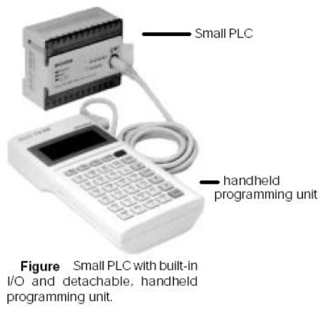
Essential Equipment and Tools
Programming Devices
Laptop or Desktop Computer: The primary tool for PLC programming, often used with specific software like Rockwell Automation's Studio 5000 or Siemens' SIMATIC Step 7.
Hand-held Programming Devices: Used for smaller PLCs, these are portable and easy to use

Slide 25
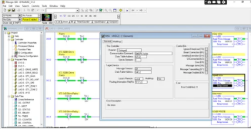
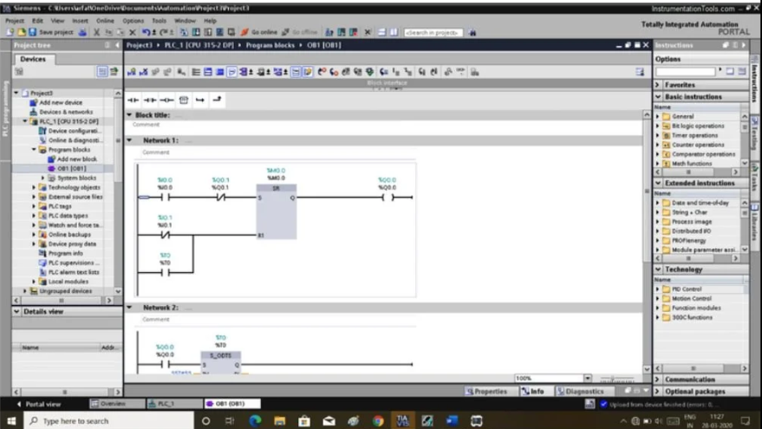
Software and Programming Languages
PLC Programming Software: Specific to each PLC brand, such as RS Logix for Allen-Bradley or STEP 7 for Siemens.
Programming Languages: Commonly includes relay ladder logic, function block diagrams, and sequential flow charts
Allen Bradley PLC Programming
Siemens PLC Programming

Slide 26
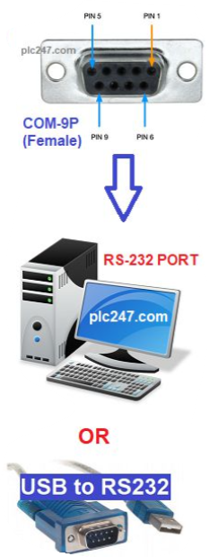
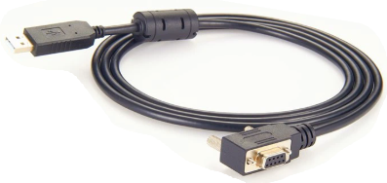
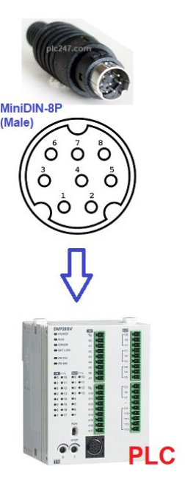
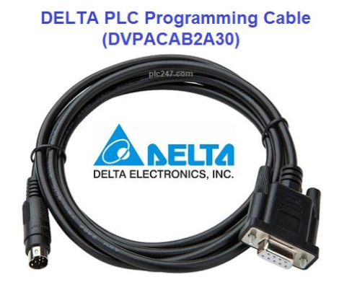
Programming Cables and Connectors
USB to PLC Interface Cables: For connecting the laptop to the PLC.
Ethernet Cables: Commonly used for networked PLC systems.
Serial Cables (RS-232 or RS-485): Used for older systems or specific applications
USB to RS-232

Slide 27



